Slide 1

Katas Fall 2023
Toronto
Moscow
Tokyo
Sao Paolo
Road Warrior
Iconites

Slide 2

Hobbies
Traveling
Beach
Photography
Camping
Goals and Aspirations
Explore new cultures deeply.
Create lasting travel memories.
Achieve travel independence.
Likes
Food
Sarah Foster, 23
Social Networking
Exercising
“Adventure is my best souvenir.”
Dislikes
Busy Applications
Being Disconnected
Chaotic Trip Planning
Iconites

Slide 3





Introducing Road Warrior
Explore, Reserve, Travel
Identity Management
Email Triggers
Identity management, ensuring secure and personalised user experiences.
Email webhooks are the silent heroes ensuring you're always in the know, delivering real-time updates to your travel plans.
Trip Management
Social Media Sharing
Effortless trip management empowers travellers to tailor their journeys with ease.
Collaborate seamlessly with your travel companions, making trip planning an enjoyable shared experience.
Third-Party Integrations
Reporting & Analytics
Seamless third-party integrations expand our app's horizons, bringing the world of travel to your fingertips.
Harness the power of reporting and analytics to gain valuable insights into your travel patterns and make more informed decisions.
Iconites

Slide 4
Key Architecture Characteristics
What will drive our solution decisions?
Scalability
Scalability allows our system to efficiently handle increasing loads, ensuring consistent performance and responsiveness, even during periods of high demand
Elasticity
Elasticity allows the system to dynamically adjust resources in response to changing workloads, optimising resource utilisation and cost efficiency.
Performance
Good Performance guarantees that our system responds promptly to user interactions and delivers an exceptional user experience.
Global Availability
Global availability ensures that the system can serve users from anywhere in the world, enhancing accessibility, reliability, and user satisfaction.
Data Integrity
Data integrity safeguards the accuracy and consistency of travel information, reinforcing trust in our system and ensuring that users receive reliable and up-to-date data.
Iconites

Slide 5
Architecture Implementation
How will we target the key characteristics we outlined?
Performance
Security
Caching, Serverless Functions and good engineering practices
Private network communication and strict data access
RPA
Database
Attaching triggers to our mailbox
NoSQL for analytics, global data distribution
Application Hosting
Core Services Hosting
PWA with SSR capabilities
Kubernetes for Elasticity
Hosting
Architecture
Cloud for Scalability
Microservices, Event-Driven & Space-Based Architecture
Iconites

Slide 6
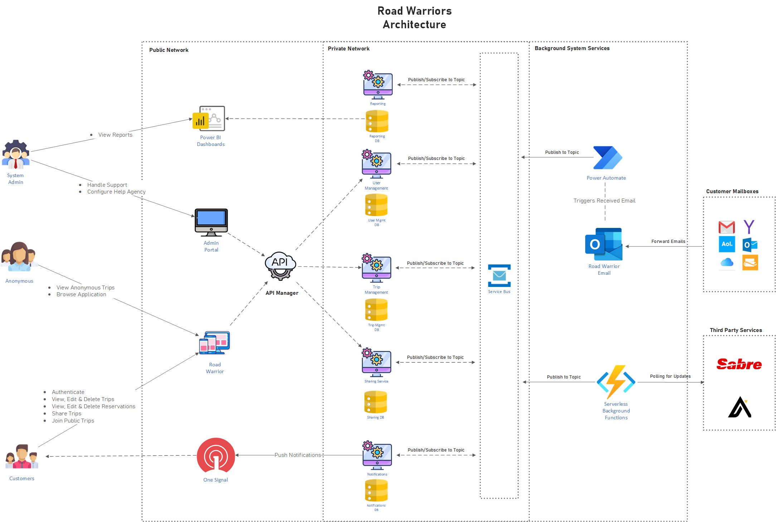
High Level View
Actors to System usage
Iconites

Slide 7
MVP Release Roadmap
How will the system be rolled out?
1 . Soft Launch
3. Subscriptions
& Analytics
The platform is now live, and users can start manually adding trips and reservations
4. Geographical
Scaling
The system will start collection data for the foundation of a recommendation engine. User Subscription model released
The system is expanding and now it is globally available. More horizontal expansions with the system are rolled out.
2. Integrations
& Sharing
Trips now receive automatic updates and users can share their trips with their travel companions
Iconites

Slide 8
THANK YOU
Iconites

